Slide 1

How To Write
Node.js Module
vunb

Slide 2
Topics.
Node.js Modules NPM Registry C/C++ Addons

Slide 3
What is
Node.js Module ?

Slide 4
npm install <something>
You Must Be Familiar With

Slide 5
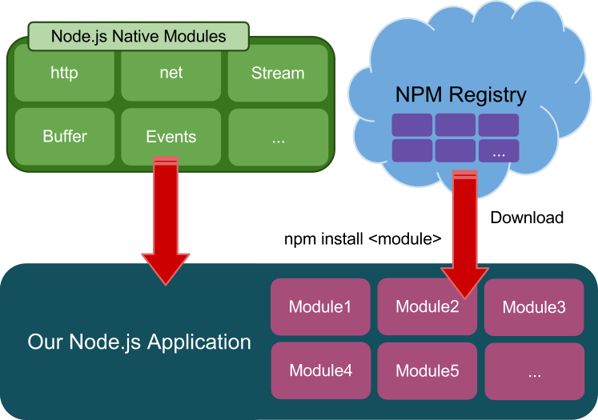

Slide 6
You Can Write Module In C/C++ & JavaScript

Slide 7
How to
Load Module

Slide 8
Load Global Module
Example:
var MyModule = require('mymodule');
Node.js will searching in the following location:
./node_modules
../node_modules
$HOME/.node_modules
$HOME/.node_libraries
$PREFIX/lib/node

Slide 9
Load Local Module
Load the module in the same directory:
var MyModule = require('./mymodule');
Or
var MyModule = require('./mymodule.js');

Slide 10
Write The First
Node.js Module

Slide 11
The First Module Example
module.exports = function() {
console.log('Hello World!');
};

Slide 12
require() module.exports
Bridge between app and module

Slide 13
Implement a Class in Module
module.exports = function() { var self = this;
this.counter = 0;
this.pump = function() { self.counter++;
};
};

Slide 14
More JavaScript Styles
var Pumper = module.exports = function() { this.counter = 0;
};
Pumper.prototype.pump = function() { Pumper.counter++;
};

Slide 15
Export Objects and Constants
var Pumper = module.exports.Pumper = function() { this.counter = 0;
};
Pumper.prototype.pump = function() { Pumper.counter++;
};
module.exports.Pumper1 = function() { ... }; module.exports.Pumper2 = function() { ... }; module.exports.Birthday = 714;

Slide 16
index.js
&
index.node

Slide 17
./example/index.js
var ex = require('./example');

Slide 18
Let's
Publish Your Module

Slide 19
NPM Registry
NPM = Node Package Manager

Slide 20
NPM Registry
npmjs.org

Slide 21
Steps to Publish Package

Slide 22
Get NPM Account
Generate package.json
To Upload Package

Slide 23
Get NPM Account

Slide 24
npm adduser

Slide 25
Initialize Package

Slide 26
npm init
Output: package.json

Slide 27
Run "npm init"
$ npm init
Package name: (demo) Description: Hello Package version: (0.0.0) Project homepage: (none)
Project git repository: (none) Author name: vunb
Author email: (none) vunb@nodejs.vn Author url: (none)
Main module/entry point: (none) Test command: (none)

Slide 28
We got package.json
{
"author": "vunb <vunb@nodejs.vn>", "name": "demo",
"description": "Hello", "version": "0.0.0", "repository": {
"url": ""
},
"dependencies": {}, "devDependencies": {}, "optionalDependencies": {}, "engines": {
"node": "*"
}
}

Slide 29
Normal Structure of Package
index.js
package.json
README (README.md)
LICENSE
lib/hello1.js
lib/hello2.js
test/test1.js
test/test2.js

Slide 30
I don't want to use index.js !
Change Entry Point

Slide 31
Add "main" Property To
package.json

Slide 32
After Change Entry Point
demo.js
package.json
README (README.md)
LICENSE
lib/hello1.js
lib/hello2.js
tests/test1.js
tests/test2.js

Slide 33



require()
Open Directory
package.json
index.js index.node
Another Entry Point

Slide 34
Upload Package

Slide 35
npm publish .

Slide 36
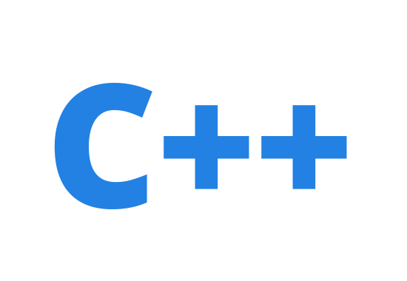
Advanced Topic

Slide 37
How to
Write C/C++ Addons

Slide 38
Development Environment
GCC (used to compile)
Python (For build script)

Slide 39
Write The First
C/C++ Addon

Slide 40
C/C++ Addon Example
#include <node.h> #include <v8.h>
using namespace v8;
Handle<Value> Method(const Arguments& args) { HandleScope scope;
return scope.Close(String::New("world"));
}
void init(Handle<Object> target) {
target->Set(String::NewSymbol("hello"), FunctionTemplate::New(Method)->GetFunction());
}
NODE_MODULE(hello, init);

Slide 41


C/C++ Addon Example
#include <node.h> #include <v8.h>
using namespace v8;
module.exports
Handle<Value> Method(const Arguments& args) { HandleScope scope;
return scope.Close(String::New("world"));
}
void init(Handle<Object> target) {
target->Set(String::NewSymbol("hello"), FunctionTemplate::New(Method)->GetFunction());
}
NODE_MODULE(hello, init);

Slide 42



C/C++ Addon Example
#include <node.h> #include <v8.h>
using namespace v8;
Handle<Value> Method(const Arguments& args) { HandleScope scope;
return scope.Close(String::New("world"));
}
function() { return 'world';
}
void init(Handle<Object> target) {
target->Set(String::NewSymbol("hello"), FunctionTemplate::New(Method)->GetFunction());
}
NODE_MODULE(hello, init);

Slide 43
Compare with JavaScript Version
var target = module.exports;
target['hello'] = function() { return 'world!';
};
Or
module.exports.hello = function() { return 'world!';
};

Slide 44


C/C++ Addon Example
#include <node.h> #include <v8.h>
using namespace v8;
Handle<Value> Method(const Arguments& args) { HandleScope scope;
return scope.Close(String::New("world"))
}
void init(Handle<Object> target) {
target->Set(String::NewSymbol("hello"), FunctionTemplate::New(Method)->GetFunction());
}
NODE_MODULE(hello, init);

Slide 45



C/C++ Addon Example
#include <node.h> #include <v8.h>
using namespace v8;
Handle<Value> Method(const Arguments& args) { HandleScope scope;
return scope.Close(String::New("world"))
}
v8::String Class
void init(Handle<Object> target) {
target->Set(String::NewSymbol("hello"), FunctionTemplate::New(Method)->GetFunction());
}
NODE_MODULE(hello, init);

Slide 46
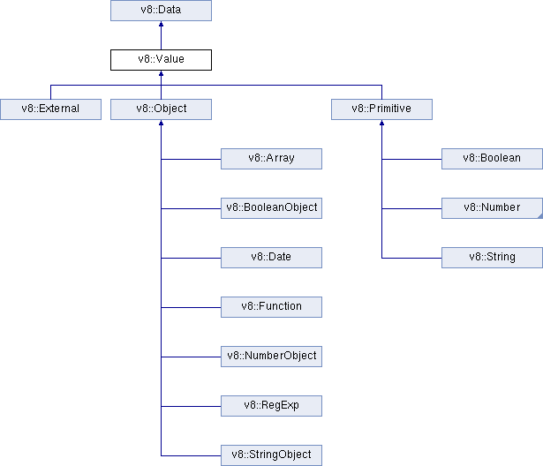

Slide 47

C/C++ Addon Example
#include <node.h> #include <v8.h>
using namespace v8;
Handle<Value> Method(const Arguments& args) { HandleScope scope;
return scope.Close(String::New("world"))
}
void init(Handle<Object> target) {
target->Set(String::NewSymbol("hello"), FunctionTemplate::New(Method)->GetFunction());
}
NODE_MODULE(hello, init);

Slide 48
HandleScope
Determine Lifetime of handles
Often created at the beginning of a function call
Deleted after function return
scope.Close(<Handle>) to avoid handle being deleted by Garbage Collection

Slide 49
Compile The First
C/C++ Addon

